Slide 1
The Prophet Moses
Chapter 6
God desired to free His people from slavery and establish a covenant with them. He chose to work through Moses, sending plagues on the Egyptians, leading the Israelites across the Red Sea, and giving them the Ten Commandments.

Slide 2
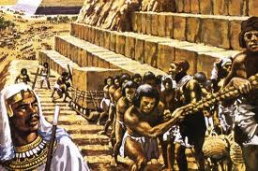
God’s chosen people.
Read textbook p. 31
Pharaoh became jealous of the Israelites and their loyalty to God. He was also afraid of their growing numbers and strength, so he forced them into slavery.

Slide 3
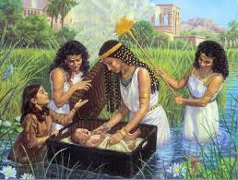
Pharaoh’s Command
Then he ordered that all of their newborn sons be thrown into the river and drowned.
But Moses’ mother hid him in a woven basket among the reeds of the river. Pharaoh’s daughter discovered him and took him to raise him in the Egyptian palace.

Slide 4
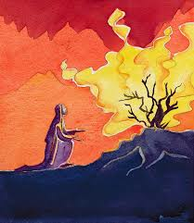
Moses
God chose Moses to free His people from slavery.
God spoke to Moses in the burning bush and told him to demand Pharaoh let His people go.
What would you do if you were Moses and God told you He wanted you to free His people from slavery?
Draw yourself talking with God

Slide 5
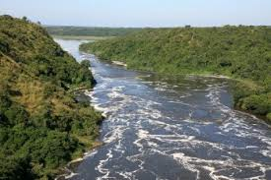
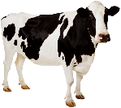
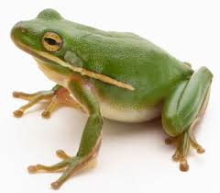
God sent plagues.
The Egyptians worshiped many things as gods.
All of the plagues were sent to prove that God is the one, true God and He is more powerful than the things the Egyptians worshiped.

Slide 6
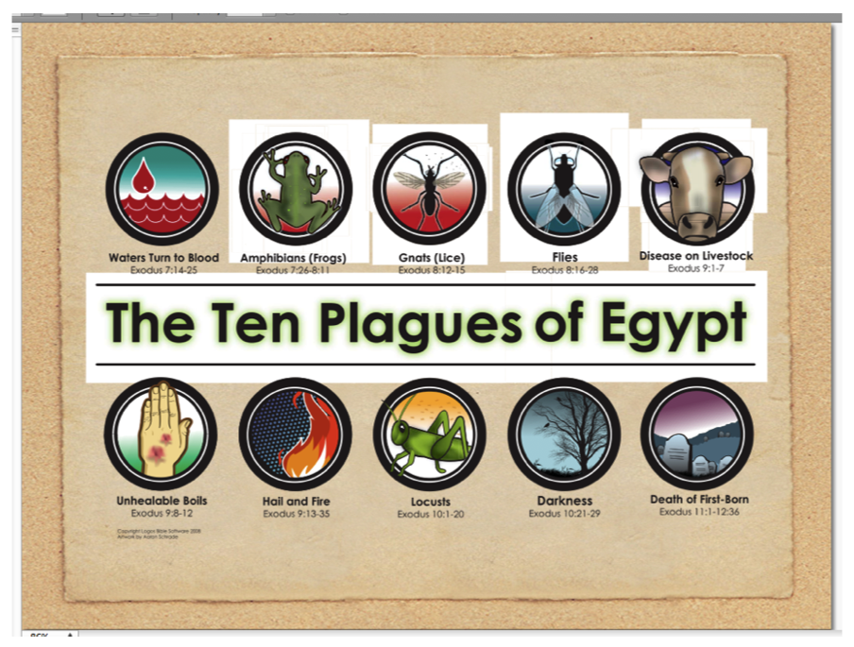

Slide 7
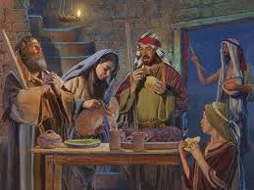
Passover
At the Passover meal, the Israelites had to sacrifice and eat a lamb (the Paschal lamb) in order to be saved from the Angel of Death.

Slide 8
A new Paschal lamb
Jesus is the Lamb of God.
Was Jesus sacrificed?
(On the cross)
Is Jesus eaten?
(at Communion)
How does that save us from death?
(frees us from sin and gives us grace)
Jesus is the new Paschal lamb because he was sacrificed on the cross and we receive him in the Eucharist. He frees us from slavery to our sins.

Slide 9
In the Desert
After the death of the Egyptians’ first born sons, Pharaoh agreed to let the Israelites go.
God opened the Red Sea to allow the Israelites to escape. This prefigures Baptism, where we
God led them through the desert in pillar of cloud by day, and a pillar of fire by night.
(Activity)
God provided for His people by protecting them from the Egyptians, giving them water and food in the desert, and leading them on their journey.

Slide 10
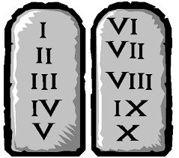
Ten Commandments
God gave Moses the Ten Commandments.
Partner up! How many of the Ten Commandments can you list?
God made a covenant with His people
Covenant- promise that makes us family and calls us to responsibilities
God gives us His law to make us happy and holy!

