Slide 1
The from Grace
Fall
Chp. 6

Slide 2
Tests!
  Only those who have the gift of reason can take tests (a power of the soul)
Why do we have tests? (because teachers are mean?)
  To encourage us to learn what we need
  To help us know what we have really learned
Why does God give/allow tests? (because He is mean?)
  To encourage us to learn what we need
  To help us know what we have really learned
  Love is not truly love unless we choose to love

Slide 3
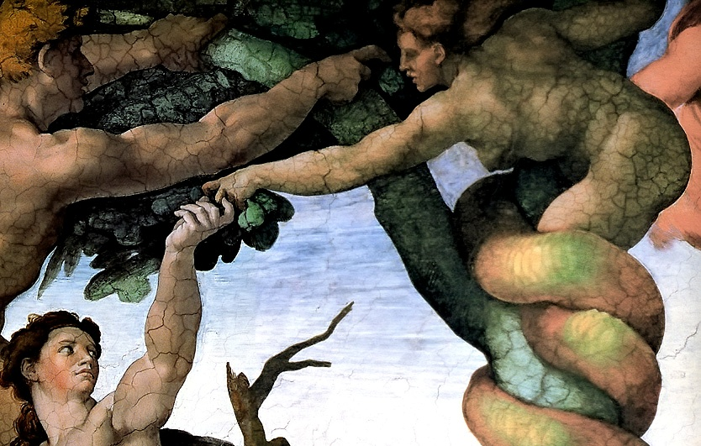
The Test!
God allowed Adam & Eve to be tested to see if they truly loved Him.
Read Genesis 3:1 ff.
Why did Eve doubt God?
Why would she believe the devil?
What is it called when we start to doubt God?
  Temptation
Where was Adam? Why didn’t he come to the rescue?
Was Eve worse because she ate first?
  At least she questioned the devil (but this always gets us in trouble because he can easily outsmart us!)
  Adam just takes the fruit from her and eats it without any hesitation
  Adam and Eve are both equally guilty!
L I A R !!!
Notes:
Read and discuss Genesis 3. Point out how Eve didn’t give any thought to evil before the devil tried to tempt her. When he said, “You certainly will not die!” he directly lied and contradicted what God had said. That should have been an obvious clue to Eve not to listen to him. She had no reason to doubt God, but her pride started to get her questioning His goodness.
It’s easy for children to see how Eve was guilty, but not always as obvious with Adam. However, it’s “fun” to ask them who was more guilty.
Point out that Adam’s job was to protect Eve. He might have been partly off the hook if he had been in another part of the garden. But then read the Scripture aloud to the students when it says, “She handed the fruit to the man, who was with her, and he ate it.” He watched the whole temptation take place, did nothing about it, and then made the choice to sin as well (Eve didn’t force him!)

Slide 4
The Test!
Immediately their eyes were opened and they knew they were naked.
They were ashamed and sewed fig leaves together for clothes.
They hid from God.
  Sin makes us want to hide from God!
  If Adam & Eve would have run to God instead and said they were sorry, would He have forgiven them?
  Story of St. Therese and the wallpaper
Notes:
Maturity level of students will influence how they handle Adam & Eve being naked. It sometimes help to use the analogy of a rabbit or squirrel – are they ashamed to not be wearing clothes? Certainly not! Before sin, there was no shame in being naked.
Really focus on the mercy of God and how he gave Adam and then Eve several chances to admit they had done wrong and to apologize, but they never did.
St. Therese, as a little girl, had a great love for her father. Every day when he would come home from work she would run to the door and jump into his arms. One day she had been playing in the bathroom and ripped the wallpaper. Instead of hiding this from her parents or pretending she didn’t do it, she ran up to her father when he came home, jumped into his arms and immediately told him what she did and that she was sorry. Of course, he forgave her. God would have done the same for Adam and Eve.

Slide 5
Blame and Guilt: Sin
“The woman You put here with me; she gave it to me so I ate it.”
“The serpent tricked me into it.”
“It’s not MY fault!!!” Really???
When do we blame others for our sins/mistakes?
Notes:
Rather than own up to our sinfulness, we tend to blame others. We see how Adam and Eve did this. Reflect on times that we act this way.

Slide 6
What was the real sin?
Eating Fruit?
  No!
Wanting to be God?
  Pride
  Disobedience
No!
My Way!
Notes:
Make sure students are clear that eating a fruit was not the sin! Disobedience and pride were what made it a sin. God had given them permission to eat from all the rest of the trees.

Slide 7
The Curse
Eve
  You will have great pain giving birth to children.
Adam
  You shall have to work hard to make a living.
Both
  You are dust and unto dust you shall return. (You shall now die!)
  You are banished from the Garden
Suffering entered the world because of sin; but God can bring good even from the worst evil!
Notes:
It helps to point out that God wasn’t mean to drive them out of the garden – or just a “punishment.” The Tree of Life was also in the garden. He speaks of driving them out “lest they reach out to eat from its fruit” as well. If they had, they would then immortalize their bodies in this state of sin as well as their souls. Driving them away from this further temptation was an act of mercy on God’s part.
If children ask about where Eden is, etc., it’s safe to say we don’t fully know rather than trying to make up an answer.

Slide 8
Compare
Before the Fall
After the Fall
Lost grace
Out of the garden (away from God)
Blamed each other
Needed to learn
Pain and suffering
Death
Need clothes (shame)
Hard work for food
Knew good and evil and have a hard time choosing the good (Concupiscence)
Had grace
With God
Adam & Eve friends
Full Knowledge
Never sick
No death
Naked (no shame)
No hard work
Knew only good

Slide 9
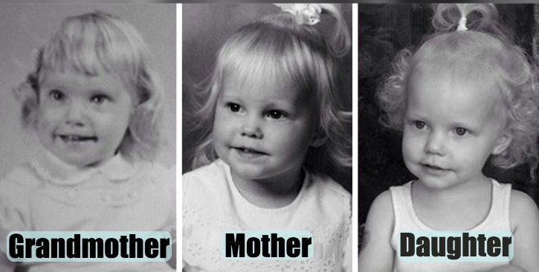
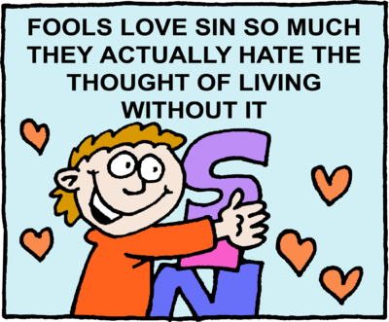
What does this have to do with me?
Our parents pass along traits to us. (height, hair color, etc.)
Our first parents, Adam and Eve, passed along Original sin and its effects to every human.
Our will now finds it easier to do bad than good – this is called concupiscence.
ChristArt.com
Notes:
Discuss how just as parents pass along various traits, so original sin is passed down from Adam and Eve to each person. Finding it easier to do bad than good is a way to describe concupiscence.

Slide 10
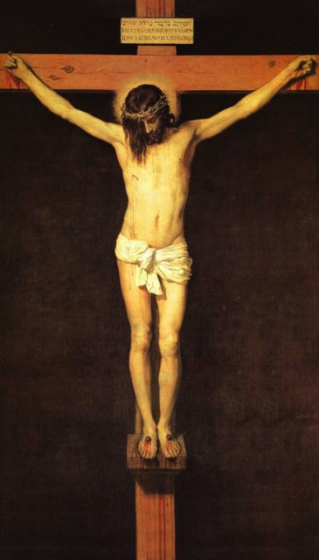
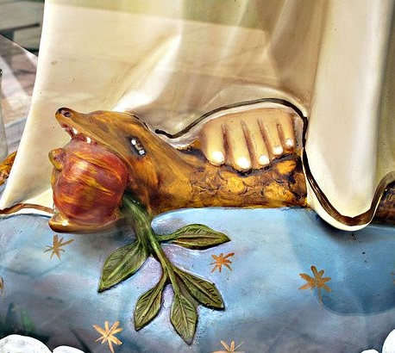
The Promise! ☺
All is not lost! God will send a Savior!
Gen. 3:15
  Who are the offspring of the woman?
  “He shall strike at your head”—who is “He”?
    1 John 3:8
  What do we usually see under Mary’s feet in statues?

Slide 11
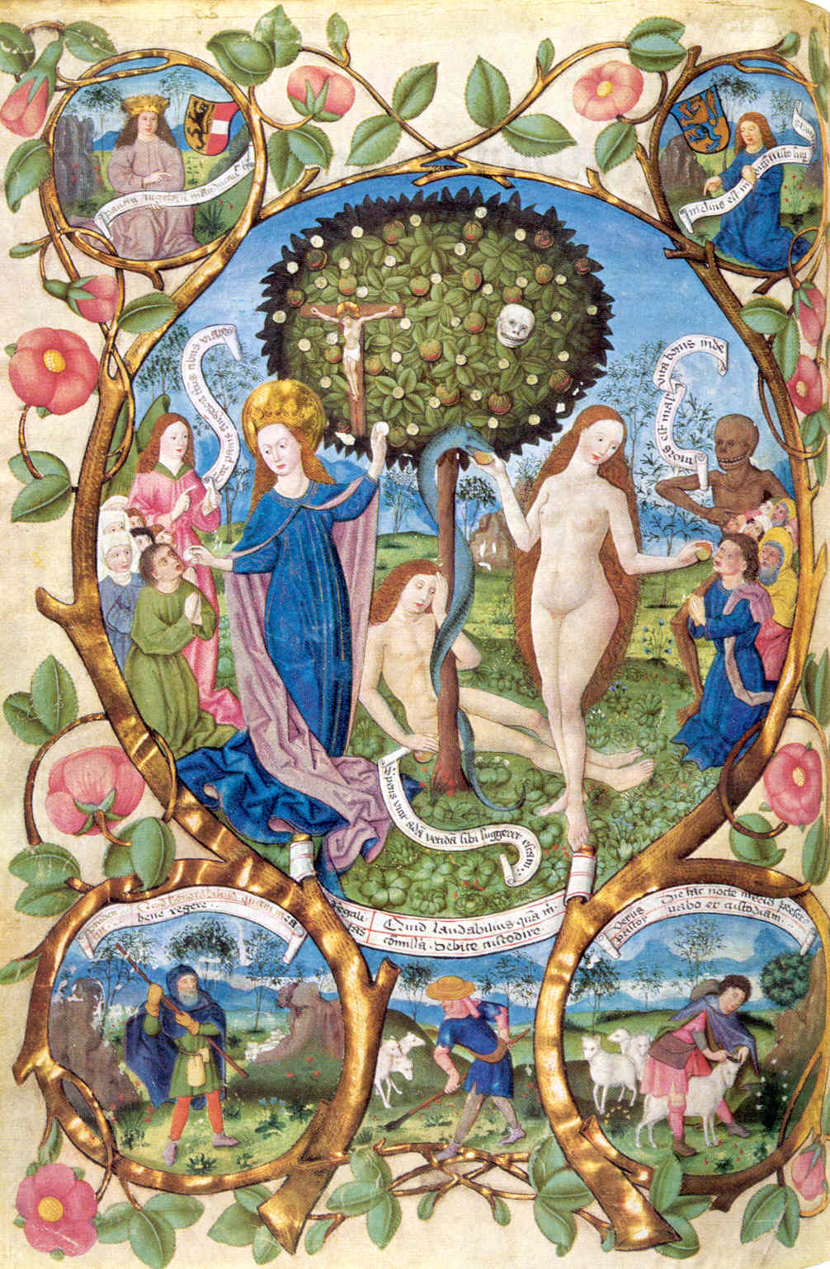
Notes:
This is a neat artwork. Ask the students to comment on what they see and how they interpret it. Some items of note:
Adam is doing nothing to protect Eve.
Eve is taking fruit from the serpent and giving it to her “children.” Behind them is a demon or death.
On Eve’s side of the tree is a skull representing Adam bringing death also.
On the other side of the tree is a crucifix showing Jesus bringing life from a “tree.”
Mary is taking fruit from the tree (looks like the Eucharist!) and feeding her “children.” Behind them is an angel representing life.

Slide 12
New Adam, New Eve
Eve said “No” to God
  Mary said “Yes” to God
Adam sinned
  Jesus took away sin
Adam & Eve were the first creation
  Jesus and Mary are the new creation (life of grace)
Gentlemen, who do you now have to imitate?
Ladies, who do you now have to imitate?
I Cor. 15:22
I Cor. 15:45
Notes:
Discuss the comparison of Adam and Eve with Jesus and Mary. Although it is easy and “natural” and easy to imitate the pride and blaming of Adam and Eve, we are given the challenge and the grace to imitate Jesus and Mary.

Slide 13
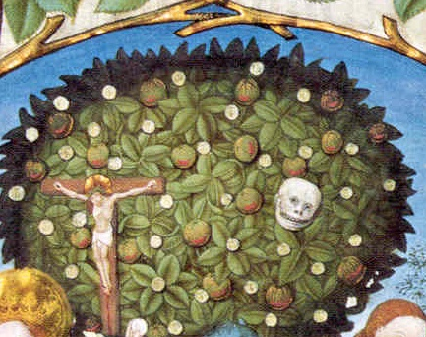
Adam
New Adam (Jesus)
Gave us human life
Brought us death
Failed to protect us from evil
Disobeyed by eating from a tree
Lost paradise for us
Gave us new life of grace
Brought us life
Fought evil by giving His life for us
Obeyed by dying on a tree (cross)
Won paradise for us (Heaven)

Slide 14
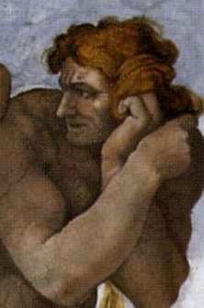
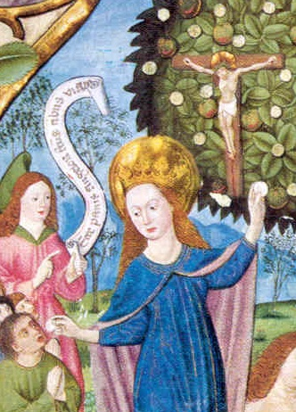
“the knot of Eve's disobedience was loosed by Mary's obedience”
Eve
New Eve (Mary)
Gave us human life – mother of all the living
Brought us death by saying “no” to God
Led us to sin
Gave us new life of grace by giving us Jesus – mother of all the living
Brought us life by saying “yes” to God
Leads us to grace

