Slide 1
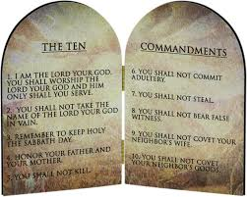
God’s Laws of Love
Chapter 7
God gave us the Ten Commandments to help us love Him and others. Jesus summarized the Ten Commandments in the great commandment of Love.

Slide 2
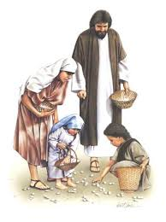
God’s people in the Desert
Read textbook p. 37
God took care of the Israelites while they were in the desert because He made a covenant with them.
He nourished them with water and…
Manna Quail
God also wanted to nourish their souls, so He gave them the Ten Commandments

Slide 3
The first three commandments help us to love God.
I am the Lord, your God: you shall not have other gods before Me.
You shall not take the name of the Lord, your God, in vain.
Remember to keep holy the Lord’s day (the Sabbath).

Slide 4
The other seven commandments help us to love our neighbor.
Honor your father and mother.
You shall not kill.
You shall not commit adultery.
You shall not steal.
You shall not lie.
You shall not covet your neighbor’s wife.
You shall not covet your neighbor’s goods.

Slide 5
Discuss
Which of the Ten Commandments is the greatest?

Slide 6
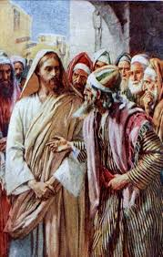
The Greatest Commandment
When people asked Jesus which commandment was the greatest, he said:
“You shall love the Lord your God with all your heart, and with all your soul, and with all your mind. This is the greatest and first commandment. The second is like it: You shall love your neighbor as yourself.”

Slide 7
Discuss:
Why should we follow the Commandments?

Slide 8
Laws of Love
God gave us these commandments because He loves us and wants us to be happy…
on earth…
and forever with Him in heaven!

