Slide 1
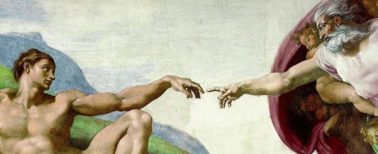
Made in His Image
Chp. 5

Slide 2






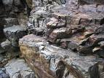
Order of Creation
God
Angels
Man
Animals
Plants
Rocks/Water
Creation Ladder
Notes:
Everything in the world is created by God and is good; but there is an order in creation.
The bottom of the Creation Ladder is what is least like God.
As we go up the Ladder, things are more complex and more like God.
Man is God’s highest creation on earth because He has an immortal soul.
Angels are higher on the Ladder because they are pure spirits (more like God).

Slide 3
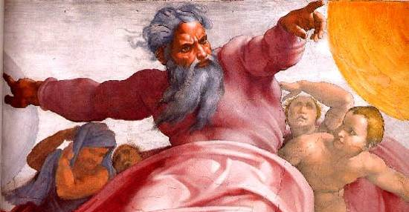
Creation of Man
Gen. 1:25-31; 2:18-25
After God created light, the earth, water, plants and animals, He created man.
Man is the only creature on earth with an immortal soul.
Notes:
Discuss the picture of God the Father creating. Note how the artist shows He is powerful.
Discuss the picture of God creating Adam. Focus especially on the hands. Ask the children, “Does God’s hand look powerful or weak?” “Does Adam’s hand look powerful or weak?” Michaelangelo shows Adam wanting life, but he cannot have it without God. God brings Adam the “spark” of life. You might also act this out in the front of the room. Have a child hold out his hand weakly while you play the part of God and reach for it, but make him wait until finally you touch it and he comes “alive.”

Slide 4
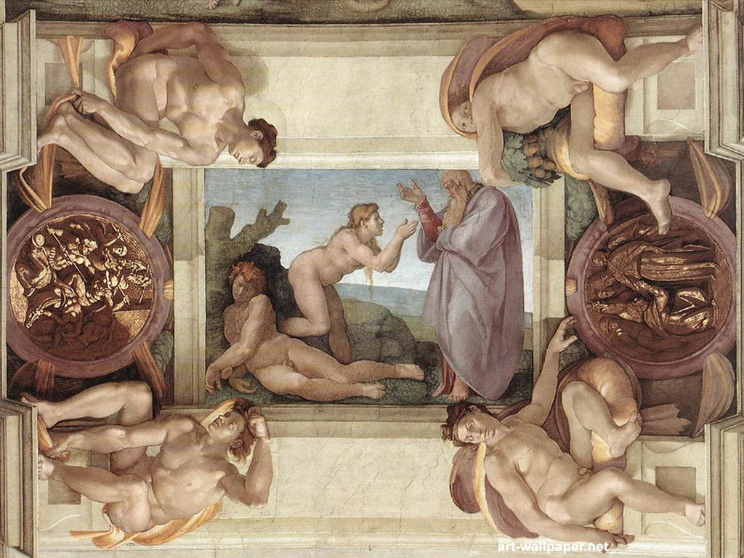
Body & Soul, Male & Female
God didn’t just give man a body – if He did man would be just like the animals.
God gave man an immortal soul, too.
God made Adam and breathed life into him.
God made Eve from a rib of Adam. She was the perfect match for Adam! (the first marriage)
Notes:
You may not spend a lot of time on it, but the last point is a good reinforcement for the fact that man and woman were created for each other (contrary to some popular social agendas).

Slide 5
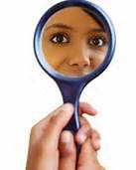
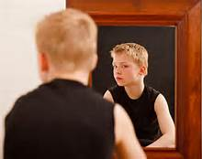
Human Soul
Man is the only creature on earth with an immortal soul.
The human soul is made in the image and likeness of God.
What is an image? If you look in a mirror, do you think you look like God? Does He have your hair color or eye color?
  No, these are physical traits.
It is your soul that is in God’s image and that
you cannot see.
Notes:
Pause before the 3rd bullet point: You might want to ask students to share what about them looks like their parents. They are “images” of their parents.
3rd bullet: Then ask how each of them could be made in God’s image when they look so different from one another (different eye, skin, hair color, etc.)

Slide 6
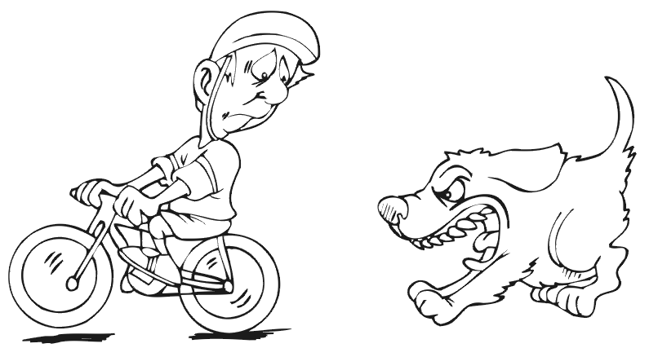
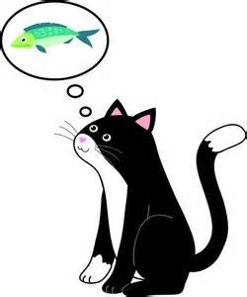

Human Soul
Even though man is body and soul, it is our immortal soul that makes us different from animals.
What can a human soul do?
  Think, choose, love
  This is what makes our souls like God.
  No other creature on earth has a soul that can do this!
  Think Can your cat plan what it will eat tomorrow?
  Choose Will your fish decide it wants to learn to read?
  Love Can a dog love its enemies?
Notes:
A fun and easy way to engage students in the 3 things a soul can do is to challenge them to say it fast. “What can a soul do?” …not “think…choose…love” but “think/choose/love” Every once in awhile as you are discussing the soul, ask the question again and see how quickly they can say the answer.
Students will often give examples of “heroic” deeds done by a dog who “loves” its master. The point with “think, choose, love” is to get them to see that there is a quality in human souls that goes beyond that of animals.

Slide 7
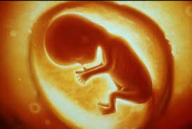
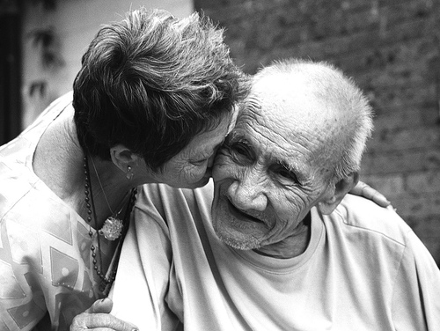
Great Dignity
=
Dignity = valuable and precious
Our immortal soul is a great gift from God.
Each human person has great dignity and is unique and special.
This dignity is given to us by God from the moment we are conceived in our mother’s womb.
From the tiniest baby, to the oldest person, to someone paralyzed in a hospital: each one has EQUAL dignity and should be treated with great respect!

Slide 8
The Garden of Eden
God gave Adam and Eve the perfect place to live on earth, called Eden.
God gave them all the plants and fruits to eat that they wanted or needed.
God placed two special trees in Eden
  Tree of Life (if they ate they would live forever)
  Tree of the Knowledge of Good and Evil (if they ate they would know how to sin)
Notes:
This slide is a quick review in anticipation of Chp. 6 when you discuss the Fall of Man.

Slide 9
Showered with Gifts
Adam and Eve were completely happy in Eden!
Natural gifts: breathe, eat, play, walk, talk, think…
Preternatural gifts:
  Impassibility
    They were never sick or suffered.
    They did not get bored.
  No concupiscence
    They had strong wills to easily choose to do good.
    They did not fight or get angry with each other.
    They were not ashamed to be naked.
  Immortality
    They would never die!
    Their bodies were holy and would not get old.
Notes:
It’s not vital that 5th graders know the “fancy” names for the preternatural gifts, but you might be surprised at how well they pick up on them.

Slide 10
The Best Gift of All…
Better than their natural gifts…
Better than their preternatural gifts…
God gave Adam and Eve a supernatural gift…
SANCTIFYING GRACE!
This meant they could:
  Share in God’s own life
  Be His children (son and daughter)
  Be able to talk freely with God
  Be able to live in heaven with God
  Pass on this gift to their children
Notes:
This is the crowning point of the lesson. After all that God had given them, the best gift they could have received – and completely undeserved – was a share in His very own life!

Slide 11
Journal Questions
What more could God have given Adam and Eve than he already gave them?
How grateful would you have been if you were them?
Notes:
These are good reflection points. Even if you don’t have students journal, giving them a couple minutes to reflect can be helpful for them to internalize the lesson.
A follow-up might be to have students draw Adam and Eve giving thanks to God.

Slide 12
To be continued…
What was the best way Adam and Eve could thank God for all these gifts?
  If they used them well, it would please God and they would stay happy.
  Unfortunately…
  …stay tuned for Chapter 6.

